Slide 1
Virtuous User Environment (VirtUE) Performer Kickoff Briefing
September 2017
APL Team: virtue@jhuapl.edu
AOS No. AOS-17-0658

Slide 2
Outline
Test & Evaluation Team
Test & Evaluation Overview
Testbed Overview
Testbed Architecture
AWS Connectivity
Security Testing
Virtue API
Performer Solution Delivery
Reference Implementation Lessons Learned

Slide 3
APL Team
Julie Tarr (Program Manager)
Chris James (Project Manager)
Jamie Castle (T&E Lead)
Systems/Security Engineering
Russ Fink
Mike Toma
Systems Integration/Software Engineering
Nate Reller
Kevin Chiou
Laura Glendenning
Test & Evaluation
Jamie Castle
Connor Daly
Mike Toma
Key Focus Areas
VirtUE Testbed: Jamie Castle
Test Plan & Metrics: Russ Fink
AWS Deployment/Operation: Mike Toma
APL’s Virtue Reference Implementation: Nate Reller

Slide 4
Performer Liaisons
APL sub-teams identified to support close and continuing interaction with performers teams. Sub-teams will become resident experts on performer solutions and facilitate information sharing and dry run testing efforts
Siege Technologies
Russ Fink
Connor Daly
Star Labs
Nate Reller
Chris James
Next Century
Jamie Castle
Kevin Chiou
Raytheon
Mike Toma
Laura Glendenning

Slide 5
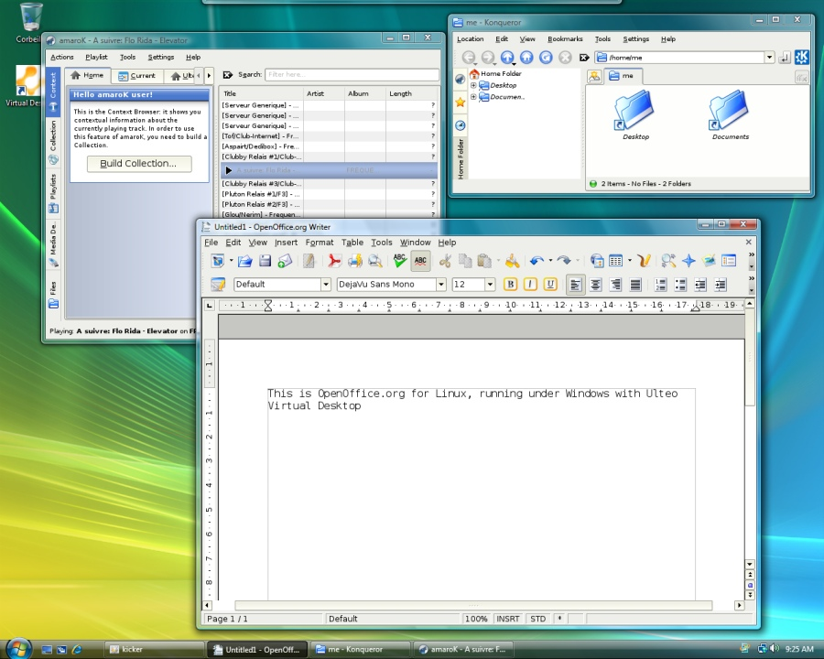
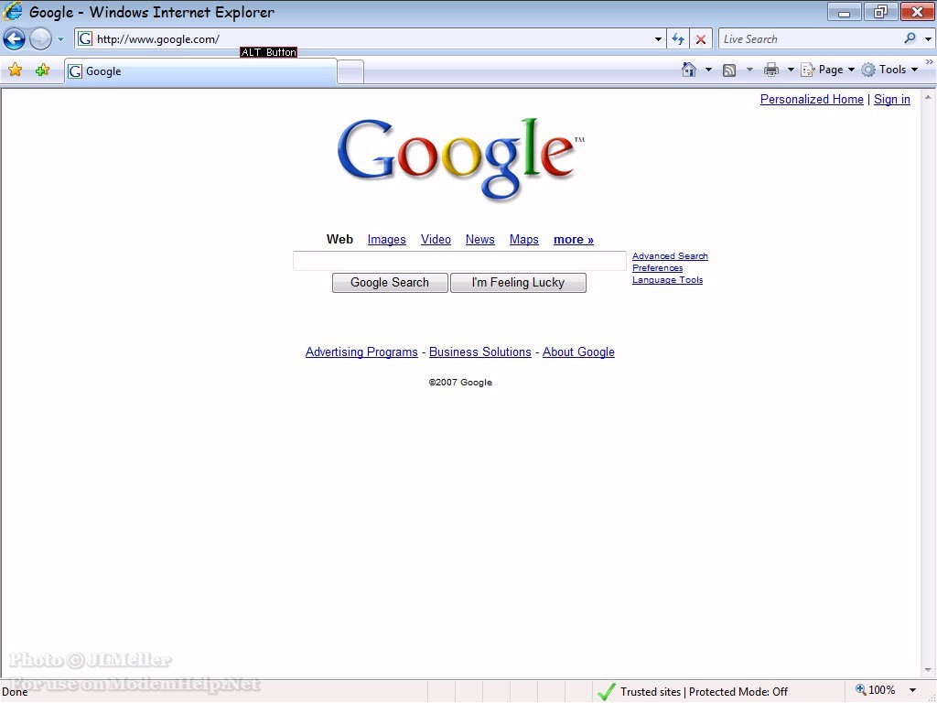




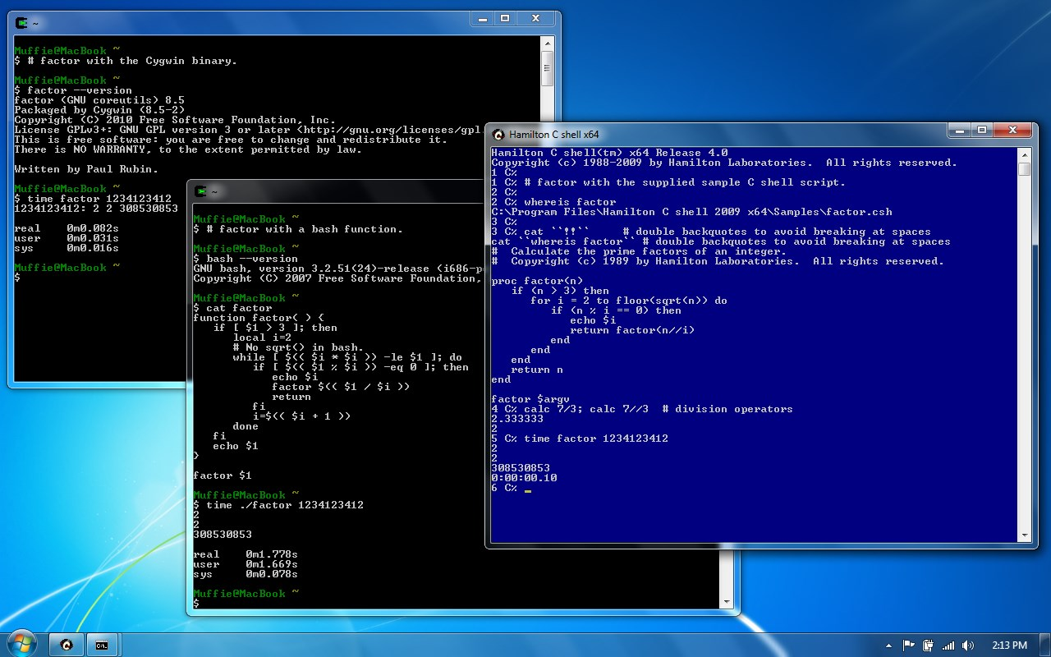
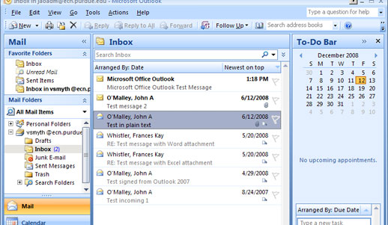


Virtue Test & Evaluation
Develop assessment methodology to enable independent verification of performer solutions
Develop testable and measurable “metrics”
Develop test plans that provide full coverage of requirements and ensure repeatable results
Develop rigorous scoring methodology (under active development)
Create a testbed architecture for performers that:
Supports a diverse technical solution space
Supports solutions at varying levels of maturity
Ensures technical integrity and fairness while under test
VirtUE Phase 1 - “The Virtuous User Environment (VirtUE) program seeks to recreate the interactive user computing environment (UCE) – turning it into a more dynamic, secure sensor and defender without alienating users.”
Commercial Cloud Infrastructure
Virtue Endpoint

Slide 6
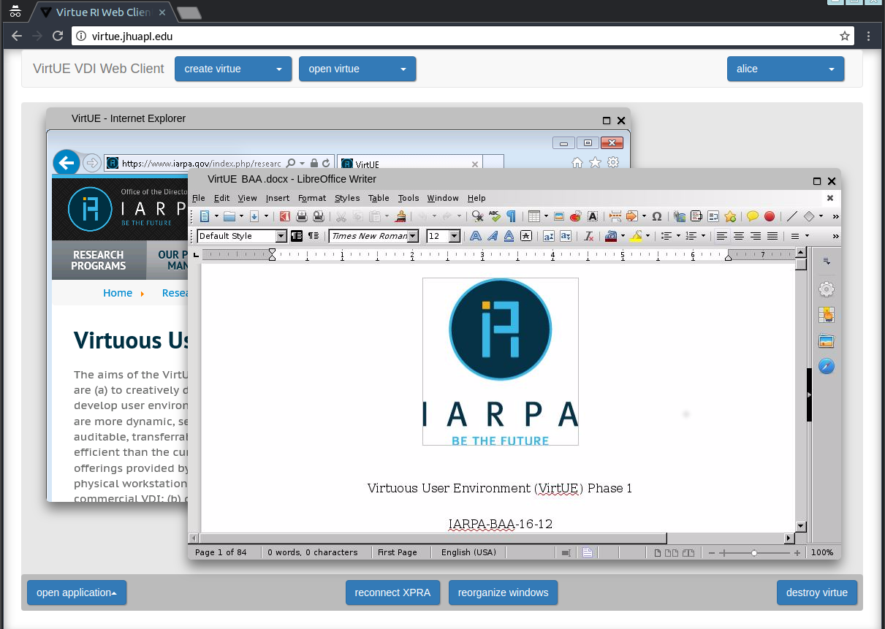
APL’s Key Activities
Reference Implementation Development

Slide 7
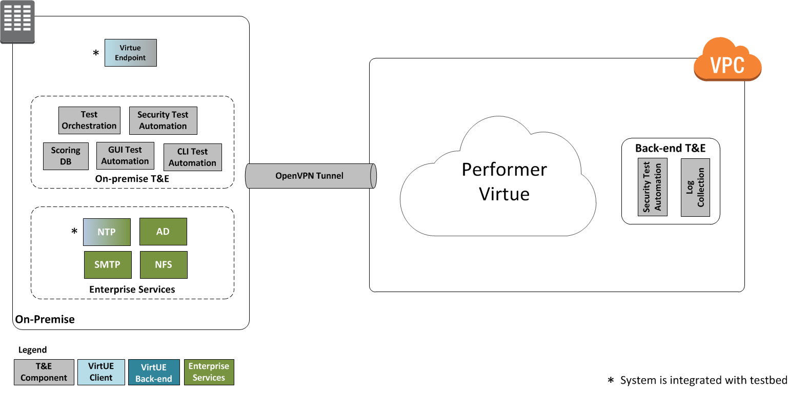
APL’s Key Activities
Reference Implementation Development
Testbed Development

Slide 8
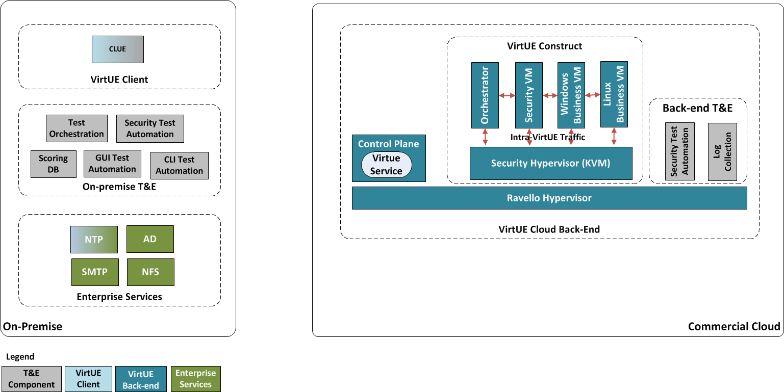

APL’s Key Activities
Reference Implementation Development
Testbed Development
Performer Test & Evaluation
Security | Functionality | Performance
Performance | Functionality | Usability | Security

Slide 9
Communications Plan
Technical Status Meetings
Meetings every two weeks with each performer and the T&E team
Email Communications
virtue@jhuapl.edu
Q&A will be released to all performers when all performers may benefit from the discussion
Use [PERFORMER SENSITIVE] in subject line if question/comment should not be disclosed to others
Site Visit
T&E team visits performer site (December of 2017)
Dry Run Test Exercise
Opportunity to deploy and verify integration of performer’s solution with T&E testbed

Slide 10
Communications Plan
Technical Status Meetings
Meetings every two weeks with each performer and the T&E team
Email Communications
virtue@jhuapl.edu
Q&A will be released to all performers when all performers may benefit from the discussion
Use [PERFORMER SENSITIVE] in subject line if question/comment should not be disclosed to others
Site Visit
T&E team visits performer site (November/December of 2017)
Dry Run Test Exercise
Opportunity to deploy and verify integration of performer’s solution with T&E testbed
Successful T&E is dependent on:
Regular communication between performers and T&E team
Openness regarding approach, capabilities, and challenges
Early integration with testbed to assess compatibility and retool as necessary

Slide 11
Communications Plan
Technical Status Meetings
Meetings every two weeks with each performer and the T&E team
Email Communications
virtue@jhuapl.edu
Q&A will be released to all performers when all performers may benefit from the discussion
Use [PERFORMER SENSITIVE] in subject line if question/comment should not be disclosed to others
Site Visit
T&E team visits performer site (November/December of 2017)
Dry Run Test Exercise
Opportunity to deploy and verify integration of performer’s solution with T&E testbed
Successful T&E is dependent on:
Regular communication between performers and T&E team
Openness regarding approach, capabilities, and challenges
Early integration with testbed to assess compatibility and retool as necessary
Nothing like a Virtue has ever been attempted before

Slide 12
Test and Evaluation Overview

Slide 13
Approach
Program Requirements
Testing Perspectives
Test Metrics
Scoring
Tailored Test Cases
Executable Test Cases
Test Cases
Test Plan

Slide 14
Requirements & Testing Perspectives
Evaluation Priorities (descending order)
Security
Functionality
Performance
Security
Virtues are more secure than currently planned User Computing Environments (UCEs) operating in commercial cloud environments
More resilient, able to withstand more attacks and recover quickly
Functionality
Virtues are capable of supporting existing UCE application suites
Users are able to effectively accomplish standard tasks while interacting with Virtues
Performance
Costs of creating, running, and maintaining Virtues in commercial clouds are not unreasonable, compared to UCEs
Virtue Requirements (IARPA-BAA-16-12 Oct. 2016)
ID | Requirement | Func | Perf | Sec
1 | Proposers shall devise a repeatable, automated secure means of storing, launching, and interacting with their Virtues within the AWS infrastructure. | X
2 | Virtues shall present themselves as atomic, largely immutable entities to other Virtues and external processes. They shall be simpler and more modular than current VDI solutions with a minimized attack surface. |  |  | X
3 | Virtues shall be role-based. |  |  | X
4 | Virtues shall be built on a more defensible virtualized construct than the current general purpose VDI VM to address threats expected on a public cloud. |  | X | X
5 | Virtues shall offer numerous logging capabilities and be capable of dynamically adjusting their sensoring when commanded by the Analytics/Control Layer to address newly suspected threats. | X |  | X
6 | Virtues shall offer numerous protection options tailored to the expected risks of the environment. They shall demonstrate the capability to respond dynamically by invoking various protections once security analytics determine the possibility of suspicious behavior. | X |  | X
7 | Virtues shall be capable of invoking and interacting with several legacy applications (including several Windows apps). | X | X
8 | Virtues shall be capable of securely saving, passing, and retrieving basic state information (hyperlinks, file locations, individual files, default printers, etc.) with each other (Virtue-to-Virtue) and also with a secure Analytics/Control Layer (Virtue-to-Control Layer). | X | X | X
9 | Proposers shall provide an intuitive presentation interface allowing access to numerous authorized Virtues to provide all the functionality required by a user delivered securely to an end device. | X | X | X
10 | Virtues shall be capable of interacting with their environment in a performant manner. | X | X
11 | Proposers shall provide methodology and utilities to define, construct, assure, and transport Virtue images. | X | X

Slide 15
Requirements & Testing Perspectives
Evaluation Priorities (descending order)
Security
Functionality
Performance
Security
Virtues are more secure than currently planned User Computing Environments (UCEs) operating in commercial cloud environments
More resilient, able to withstand more attacks and recover quickly
Functionality
Virtues are capable of supporting existing UCE application suites
Users are able to effectively accomplish standard tasks while interacting with Virtues
Performance
Costs of creating, running, and maintaining Virtues in commercial clouds are not unreasonable, compared to UCEs
Virtue Requirements (IARPA-BAA-16-12 Oct. 2016)
ID | Requirement | Func | Perf | Sec
1 | Proposers shall devise a repeatable, automated secure means of storing, launching, and interacting with their Virtues within the AWS infrastructure. | X
2 | Virtues shall present themselves as atomic, largely immutable entities to other Virtues and external processes. They shall be simpler and more modular than current VDI solutions with a minimized attack surface. |  |  | X
3 | Virtues shall be role-based. |  |  | X
4 | Virtues shall be built on a more defensible virtualized construct than the current general purpose VDI VM to address threats expected on a public cloud. |  | X | X
5 | Virtues shall offer numerous logging capabilities and be capable of dynamically adjusting their sensoring when commanded by the Analytics/Control Layer to address newly suspected threats. | X |  | X
6 | Virtues shall offer numerous protection options tailored to the expected risks of the environment. They shall demonstrate the capability to respond dynamically by invoking various protections once security analytics determine the possibility of suspicious behavior. | X |  | X
7 | Virtues shall be capable of invoking and interacting with several legacy applications (including several Windows apps). | X | X
8 | Virtues shall be capable of securely saving, passing, and retrieving basic state information (hyperlinks, file locations, individual files, default printers, etc.) with each other (Virtue-to-Virtue) and also with a secure Analytics/Control Layer (Virtue-to-Control Layer). | X | X | X
9 | Proposers shall provide an intuitive presentation interface allowing access to numerous authorized Virtues to provide all the functionality required by a user delivered securely to an end device. | X | X | X
10 | Virtues shall be capable of interacting with their environment in a performant manner. | X | X
11 | Proposers shall provide methodology and utilities to define, construct, assure, and transport Virtue images. | X | X
Words such as more, most, not much different, etc. reflect the expected ongoing research nature of the solutions and corresponding evaluation methodology.
(By program’s end, the evaluation will be repeatable independently.)

Slide 16
Example Test Metrics
Security
Success rate in deterring external attacks
Functionality
Virtue can transfer text file to a different Virtue if required
Virtue can transfer a URL to a different Virtue if required
Performance
Average memory utilization per Virtue role instance
Average time to spawn a Virtue instance
Success rate in deterring infrastructure attacks
Number of exposed system calls
Six or more Virtues can be launched, operated, and interacted with concurrently
Average Virtue logon time

Slide 17
Notional Baseline
Purpose – define “normal”
How does a user normally interact?
How long does it normally take to start an instance?
What apps (e.g., satellite imagery) do users normally use?
Measure “normal”
Performance times, resources consumed
Features supported
Security provided

Slide 18
Notional Baseline
Purpose – define “normal”
How does a user normally interact?
How long does it normally take to start an instance?
What apps (e.g., satellite imagery) do users normally use?
Measure “normal”
Performance times, resources consumed
Features supported
Security provided
What the baseline likely will be…
A Virtual Desktop Infrastructure (VDI) for most features
APL Reference Implementation (RI) for missing features

Slide 19
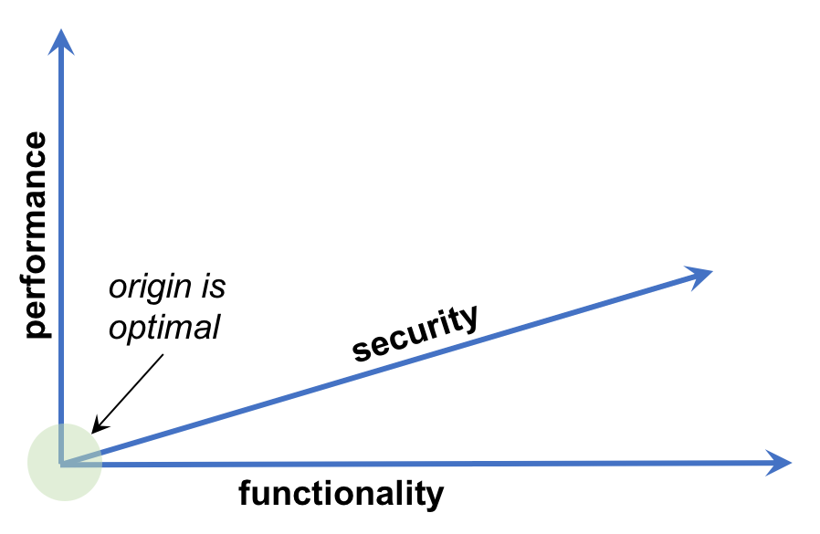
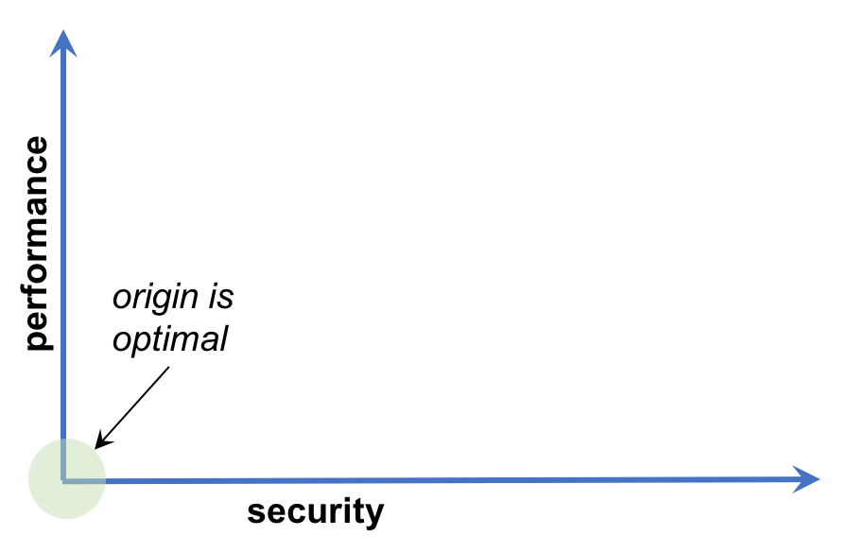
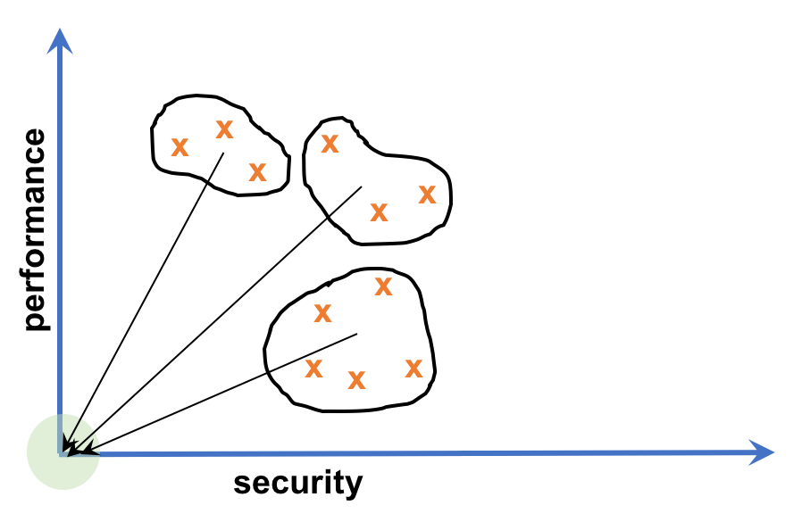
Possible Scoring Methods
Data Collection
Functionality (including usability) values
Performance (timing and resource usage) values
Security (automated attacks, red teaming, and attack surface) values
Data Representation
Overall measurement characterized as set of points in 3D space with Functionality, Performance and Security axes
Test run data collected, normalized, and aggregated into points
Data Visualization
3D space later partitioned into 2D “slices” for better visualization
Origin in 2D & 3D spaces are “optimal goals”: closer is better
Use clustering and Euclidean distance to origin to rank solutions
functionality: failures < 20%

Slide 20
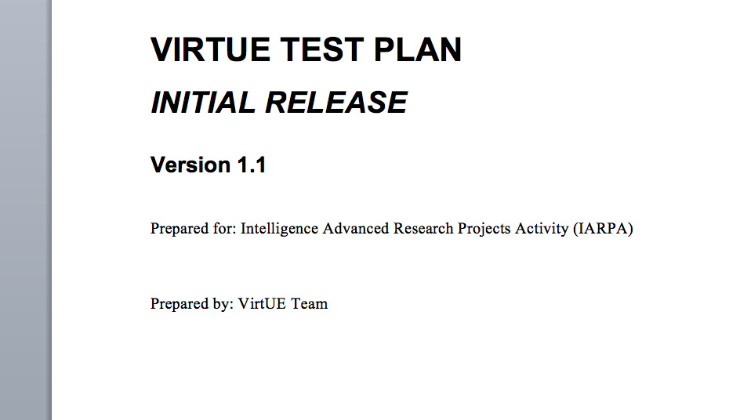
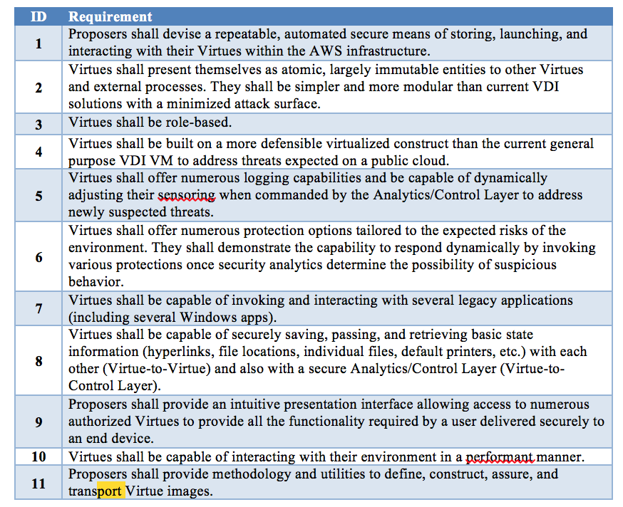
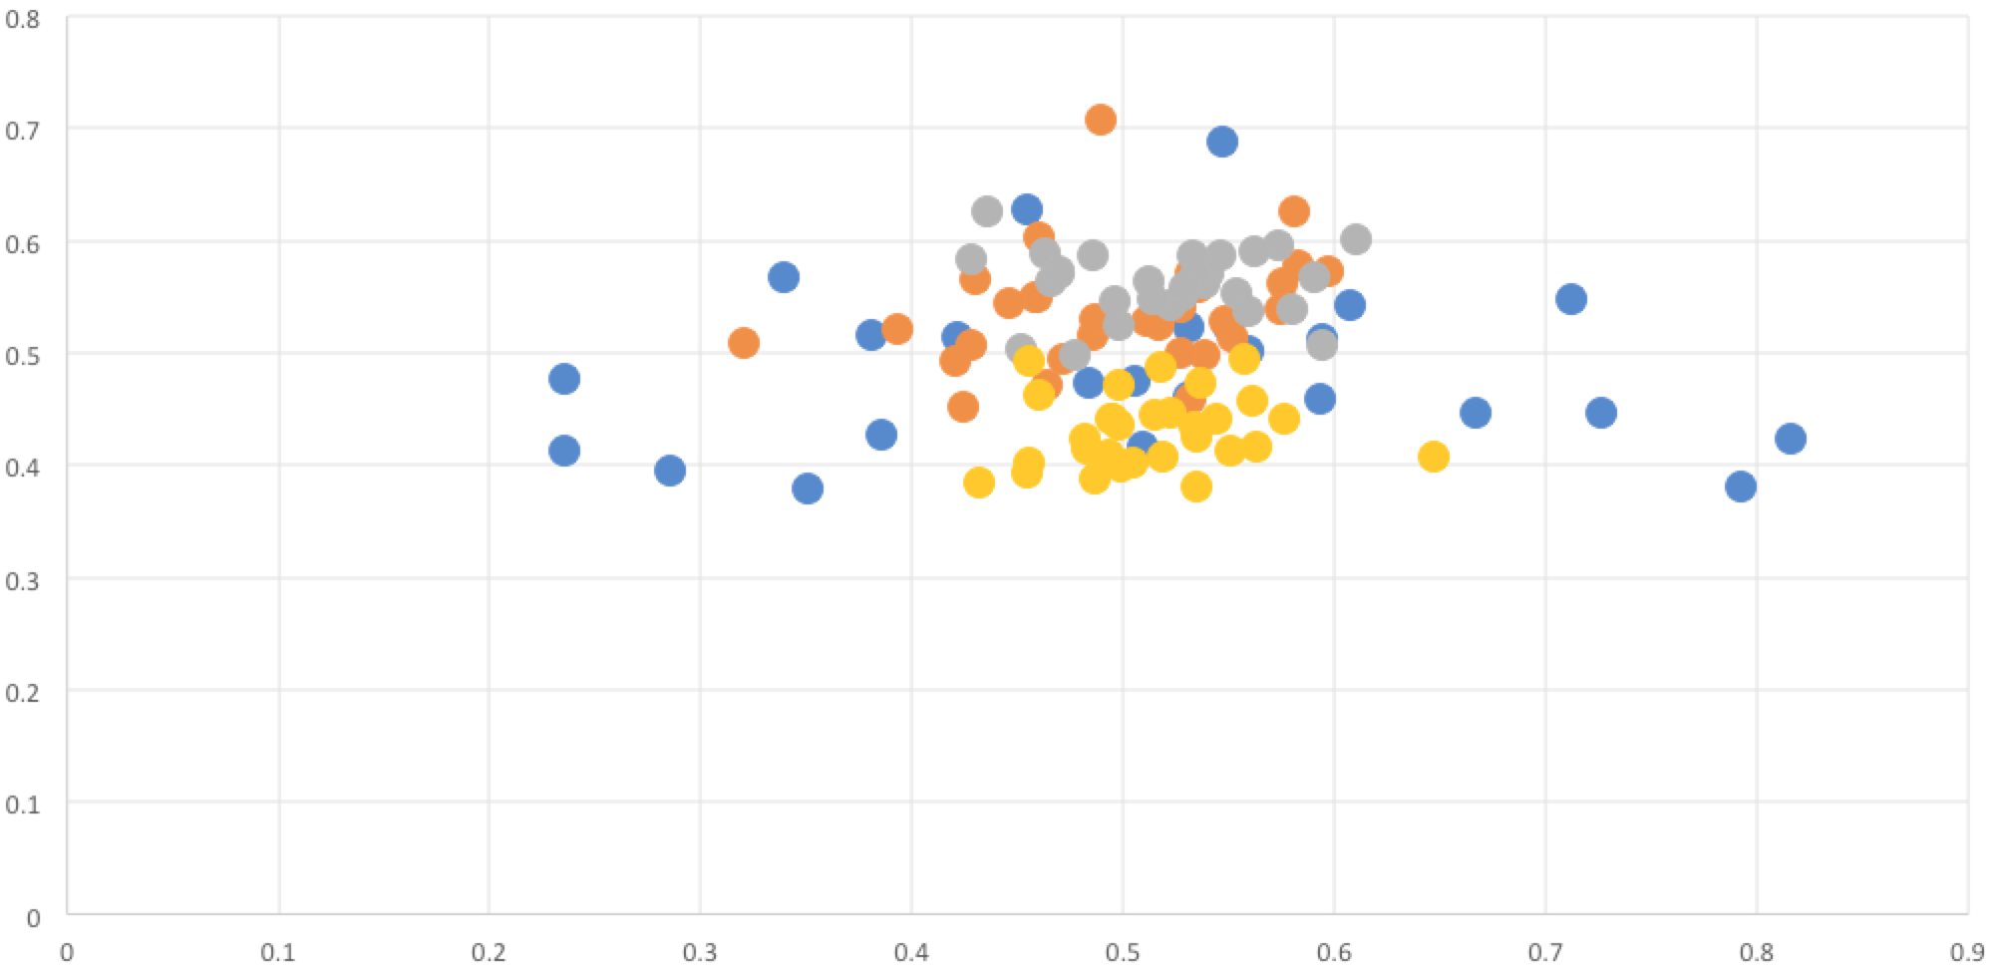
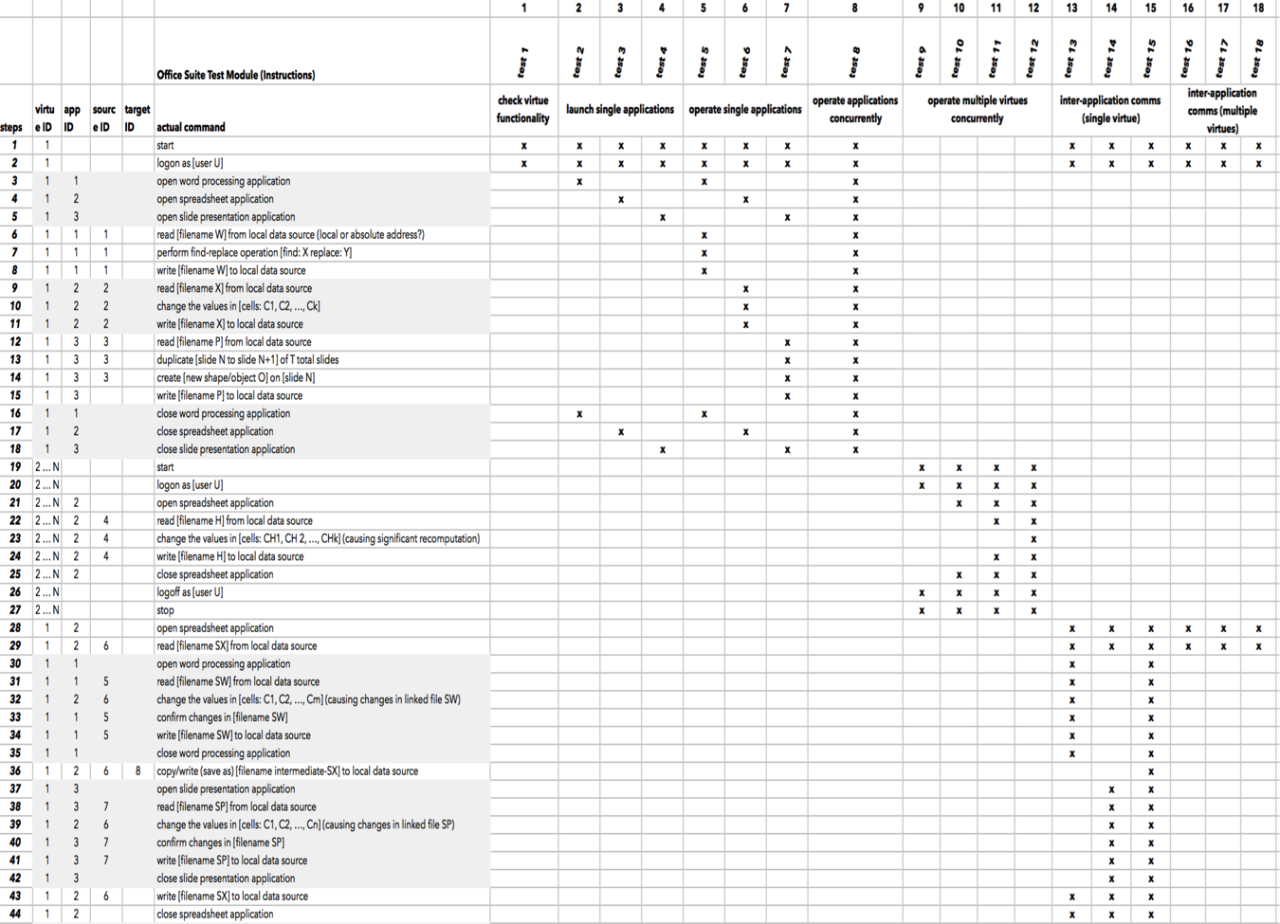
Test Plan
Planned test and evaluation methodology
Test case generation
Test case traceability
Data collection methods
Scoring
Risk Mitigation
Test Readiness
Test Event
Test Plan is under active development
Representative metrics and test cases will be socialized with performers

Slide 21
Example Test Cases
Security
Network attack surface enumeration
Malicious insider data exfiltration
Functionality
Single application test to open and close word processor
Internet browser launch to access web/Internet resource
Performance
Time to initialize and launch a Virtue (including user authentication)
Time to prepare multiple applications for user interaction
Privilege escalation
Creating a new Virtue role
Resource utilization when executing 6 Virtues simultaneously
Test cases written at a generic level to be applicable to all performer solutions
Test cases will be tailored when necessary to accommodate performer implementations
Test cases will be automated (when possible) to enable repeatable test execution

Slide 22
T&E Schedule
Mid-Term Testing (Initial)
Functionality & Performance Testing
Security Focused Testing
Analyze Data and Prepare Results
Final Testing (Detailed)
Functionality & Performance Testing
Multiple application categories
Concurrent Virtue & applications performance
Intra- and Inter-Virtue communication
Usability
Security-Focused Testing
Specific tests against each of the 4 Attack Vectors
Combined tests exploiting multiple vectors concurrently
Analyze Data and Prepare Results
Mid-Term Testing
Final Testing
Test case coverage and complexity grows with the program

Slide 23
Testbed

Slide 24
Driving Principles
Consistency
Automated testing to minimize human-in-the-loop errors
Repeatability
Central orchestration of test events and collection of results for scoring
Multiple test iterations via test automation
Integrity
Accurate time synchronization to ensure event correlation
Testbed/performer isolation to ensure integrity of test event data
Multiple test iterations to gather statistical information
Multiple test iterations to reduce “noise” resulting from network or software errors
Establishment of ground truth to enable verification of test execution
Create an open testbed architecture for performers that:
Supports a diverse technical solution space
Supports solutions at varying levels of maturity
Ensures technical integrity and fairness while under test

Slide 25
Testbed Architecture
Support Systems
Test
Automation
Test Artifact Archive
Virtue GUI Automation
Scoring System
Virtue CLI Automation
Malware Repo
Security Automation
Test Orchestrator
KEY
Command & Control Console
APL

Slide 26
Testbed Architecture
Support Systems
Test
Automation
Virtue Endpoint
Virtue Presentation Interface
Test Artifact Archive
Virtue GUI Automation
Virtue Command Line Interface
Scoring System
Virtue CLI Automation
Corporate Services
Malware Repo
Security Automation
Active Directory
NFS
Test Orchestrator
SMTP
NTP
Command & Control Console
KEY
APL
Performer

Slide 27
Testbed Architecture
APL Managed AWS VPC
APL Hosted T&E Assets (per performer)
APL Managed AWS VPC (per performer)
Corporate Services
Virtue
Endpoint
Active Directory
NFS
Virtue
Virtue
Virtue
Virtue Presentation Interface
SMTP
NTP
Virtue Command Line Interface
Support Systems
Test
Automation
Test Artifact Archive
Virtue GUI Automation
Virtue Services
Scoring System
Virtue CLI Automation
Malware Repo
Security Automation
KEY
Test Orchestrator
APL
Command & Control Console
Performer

Slide 28
Testbed Architecture
APL Managed AWS VPC
APL Hosted T&E Assets (per performer)
APL Managed AWS VPC (per performer)
Corporate Services
Virtue
Endpoint
Active Directory
NFS
Virtue
Virtue
Virtue
Virtue Presentation Interface
SMTP
NTP
Virtue Command Line Interface
OpenVPN
Tunnel
Support Systems
Test
Automation
Test Artifact Archive
Virtue GUI Automation
Virtue Services
Scoring System
Virtue CLI Automation
Malware Repo
Security Automation
KEY
Test Orchestrator
APL
Command & Control Console
Performer

Slide 29
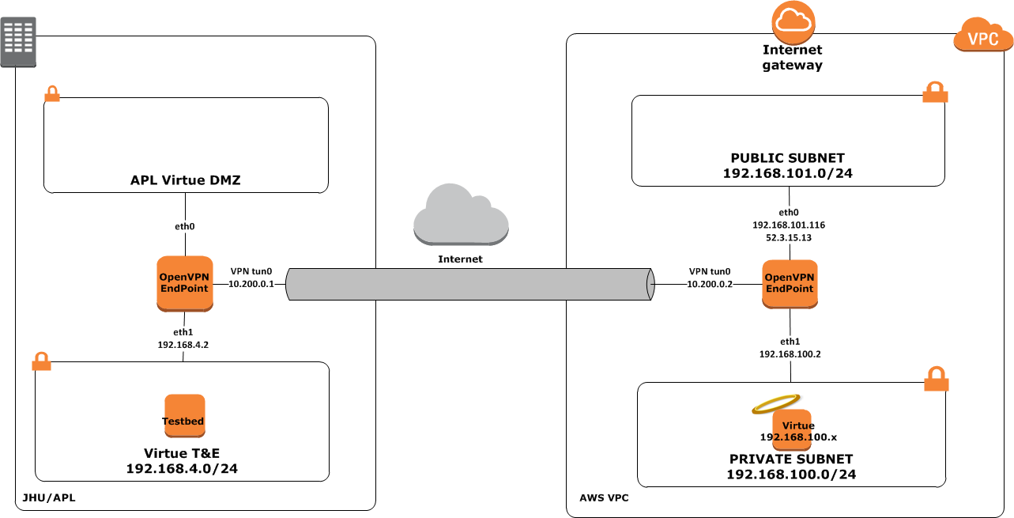
AWS Connectivity

Slide 30
Testbed Example Dataflow: Virtue GUI Testing
APL Hosted T&E Assets (per performer)
APL Managed AWS VPC (per performer)
Corporate Services
Virtue
Endpoint
Active Directory
NFS
Virtue Presentation Interface
Virtue Command Line Interface
Virtue
SMTP
NTP
OpenVPN
Tunnel
Support Systems
Test
Automation
Test Artifact Archive
Virtue GUI Automation
Virtue Services
Scoring System
Virtue CLI Automation
Malware Repo
Security Automation
KEY
Test Orchestrator
APL
Command & Control Console
Performer

Slide 31
Testbed Example Dataflow: Virtue CLI Testing
APL Hosted T&E Assets (per performer)
APL Managed AWS VPC (per performer)
Corporate Services
Virtue
Endpoint
Active Directory
NFS
Virtue Presentation Interface
Virtue Command Line Interface
Virtue
SMTP
NTP
OpenVPN
Tunnel
Support Systems
Test
Automation
Test Artifact Archive
Virtue GUI Automation
Virtue Services
Scoring System
Virtue CLI Automation
Malware Repo
Security Automation
KEY
Test Orchestrator
APL
Command & Control Console
Performer

Slide 32
Testbed Example Dataflow: Virtue Security Testing
APL Hosted T&E Assets (per performer)
APL Managed AWS VPC (per performer)
Corporate Services
Virtue
Endpoint
Active Directory
NFS
Virtue Presentation Interface
Virtue Command Line Interface
Virtue
SMTP
NTP
OpenVPN
Tunnel
Support Systems
Test
Automation
Test Artifact Archive
Virtue GUI Automation
Virtue Services
Scoring System
Virtue CLI Automation
Malware Repo
Security Automation
KEY
Test Orchestrator
APL
Command & Control Console
Performer

Slide 33
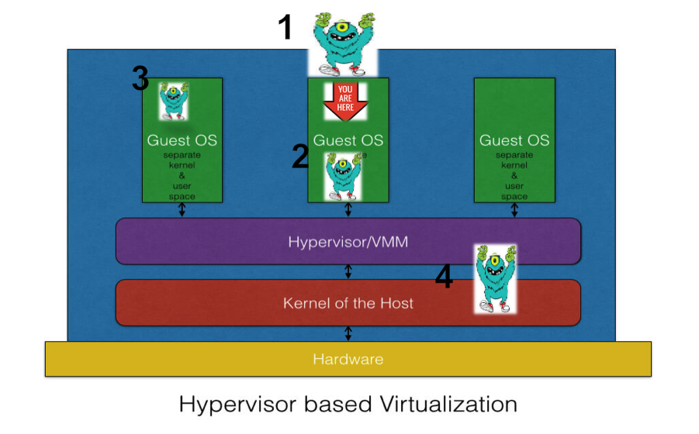
Virtue Security Testing
Security Considerations
Logging Mechanisms
Protection Mechanisms
Attack Surface Characterization
Role-based Access Controls
Defense against four threat vectors
Peer-to-Peer Attacks
External Attacks
Malicious Insider Attacks
Infrastructure Attacks
Peer to peer attacks
External attacks
Malicious
insider attacks
Infrastructure attacks

Slide 34
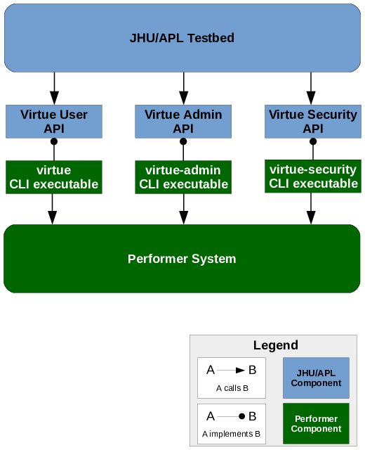
Testbed Integration via Virtue Software API
APL developed Virtue Software API document
Testbed integration challenges can be reduced by conforming to common API
Virtue Software API includes:
Virtue User API
Virtue Admin API
Virtue Security API

Slide 35
Testbed Integration via Virtue Software API
APL developed Virtue Software API document
Testbed integration challenges can be reduced by conforming to common API
Virtue Software API includes:
Virtue User API
Virtue Admin API
Virtue Security API
Meetings will be held to review the Virtue API and to discuss questions and needed modifications

Slide 36
Virtue API Examples
Virtue User API
Virtue Admin API
Virtue Security API
Logging in and out
Defining roles and authorizing users for them
Creating Virtues from a role and destroying them
Launching applications in a Virtue
Enabling and disabling sensors and protections
Attaching and detaching resources (network drives, etc.)
Importing standardized testing data (predefined users/roles)
Configuring and collecting logging data *
* in future versions

Slide 37
Performer Solution Delivery

Slide 38
Purpose
Discuss Overall Approach for Solution Delivery
What: Solution Delivery Package
Where: Target T&E AWS Account
How: AWS Resource Sharing & Access
When: Incremental Deployments

Slide 39
Virtue System Context During Exams

Slide 40
Virtue Software Package Delivery
Virtue deployment package
Deployment scripts
All scripts & templates developed to interface with AWS SDK/API
Virtue AMIs (if available)
Deployable binaries
Source code
T&E team reserves the right to build from source
Virtue information package
System & Architecture and Design
System Interface Details
Deployment Information
User Information
Administrator Information
Test Readiness Plan

Slide 41
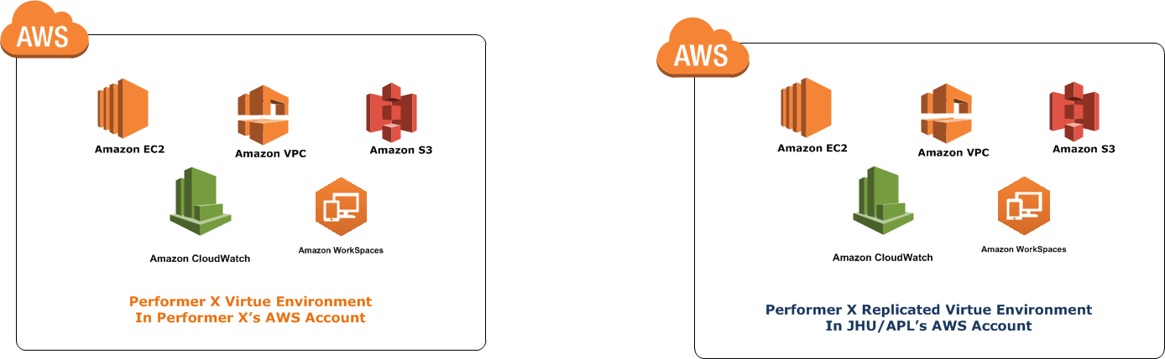
Replicating Performer AWS Environments
Performer Account
APL Account
Internal Development
Incremental Deployments in Preparation of T&E Exams
JHU/APL’s AWS Account will be used for the Test & Evaluation of Performer Solutions
Critical to ensure that the T&E environment is fully isolated & controlled during Exams

Slide 42

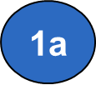


AWS Deployment Process
Performer Account
APL Account
Performer Access Into APL Account will be removed for Mid Term and Final Exams

Slide 43
Resource Sharing between AWS Accounts
Performer Account
APL Account
Shared Resource Access
No cross account resource sharing & accesses during examinations
Identify resources early on that cannot be easily reconstructed or transferred (e.g., AMIs)
Review “Limitations” Section
http://docs.aws.amazon.com/vm-import/latest/userguide/vmexport.html

Slide 44
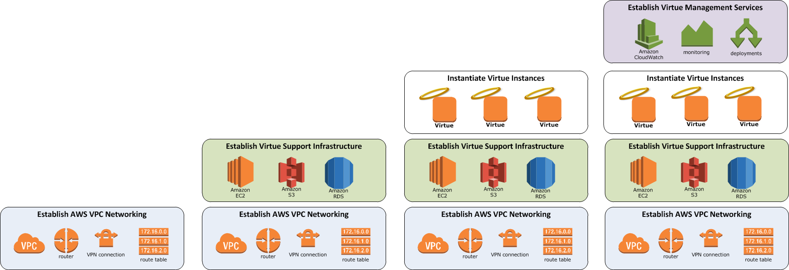
Incremental Deployments
APL Account
Start
Exam
Establish an incremental AWS environment deployment plan for each performer as a risk reduction mechanism

Slide 45
APL Virtue Reference Implementation

Slide 46
APL Virtue Reference Implementation
Purpose: Develop a rudimentary Virtue and supporting infrastructure to support testbed development and evaluation of testbed instrumentation, monitoring, and assessment capabilities
Approach:
Develop a set of virtual machine and docker images that work together to support necessary Virtue functionality. These images are nested within a single virtual machine called the security hypervisor.
Initial development deploys the security hypervisor on a local KVM instance. This image is ultimately pushed to Ravello, a service that provides nested virtualization in AWS.
The VirtUE API is implemented as a REST service that can be hosted in another AWS instance or local VM. The command line interface is mostly a thin client that proxies commands to the REST service.
The presentation layer is a web application that uses XPRA to serve applications as individual windows to the user.

Slide 47
APL Virtue Reference Implementation
Notes:
Highlight RI status and purpose

Slide 48
APL Virtue Instance
Compute Node
Virtue
Business Domain Windows VM
Business Domain
Linux VM
Security VM
Sensor
App
App
App
Sensor
Orchestrator VM
Security
Orchestrator
Orchestrator
Security Hypervisor (KVM)
Ravello Hypervisor (HVX)
AWS Hypervisor (Xen)
Notes:
Give an introduction to Ravello and why we chose it

Slide 49

APL RI Virtue Ecosystem
Virtue Support Services
Virtue
Virtue Service
Docker Registry Service
Virtue Security Operations Center (SOC)
Business Domain Windows VM
Business Domain
Linux VM
Security VM
Sensor
App
App
App
Sensor
Orchestrator VM
Security
Orchestrator
Orchestrator
Security Hypervisor (KVM)
Ravello Hypervisor (HVX)
Ravello Hypervisor (HVX)
Off-Premise
AWS Hypervisor (Xen)
On-Premise
Corporate Services
Active Directory
File Server
Virtue Endpoint
Web Application
SMTP
Time Synchronization
Virtue Command Line Interface

Slide 50
Lessons Learned
Virtualization
Cloud-Init as a configuration manager (config new VM instance, add users, etc.)
Monitor CPU and disk allocations when using nested hypervisors
Containers
Docker containers are easy to deploy, have good version control mechanism and minimize execution overhead
Unfortunately no Windows equivalent due to lack of GUI support
Remote Access
When displaying application interfaces container is SSH + application
XPRA is like screen for X11
Persistent remote display server
Client for forwarding applications and desktop screens
Network Protections
Linux Traffic Control (tc) Tools
Enables network port mirroring
Route packets with smaller footprint
Virtue Import/Export
Need to define what is the boundary of a “Virtue”
In our case we assume application is in place and only import/export role settings
Virtue Update
Separate updates into application and infrastructure updates
All updates should be tracked either through checksum or versioning
Traffic Enforcement
Notes:
Highlight this is what we chose and this is for lessons learned. Things we learned may not be the only solution/path, but we are highlighting what we learned to help performers. Performers shouldn’t feel obligated to use items noted here. There very well could be a better solution.

Slide 51
Lessons Learned
Virtualization
Cloud-Init as a configuration manager (config new VM instance, add users, etc.)
Monitor CPU and disk allocations when using nested hypervisors
Containers
Docker containers are easy to deploy, have good version control mechanism and minimize execution overhead
Unfortunately no Windows equivalent due to lack of GUI support
Remote Access
When displaying application interfaces container is SSH + application
XPRA is like screen for X11
Persistent remote display server
Client for forwarding applications and desktop screens
Network Protections
Linux Traffic Control (tc) Tools
Enables network port mirroring
Route packets with smaller footprint
Virtue Import/Export
Need to define what is the boundary of a “Virtue”
In our case we assume application is in place and only import/export role settings
Virtue Update
Separate updates into application and infrastructure updates
All updates should be tracked either through checksum or versioning
Traffic Enforcement

Slide 52
Lessons Learned
Virtualization
Cloud-Init as a configuration manager (config new VM instance, add users, etc.)
Monitor CPU and disk allocations when using nested hypervisors
Containers
Docker containers are easy to deploy, have good version control mechanism and minimize execution overhead
Unfortunately no Windows equivalent due to lack of GUI support
Remote Access
When displaying application interfaces container is SSH + application
XPRA is like screen for X11
Client for forwarding applications and desktop screens
Network Protections
Linux Traffic Control (tc) Tools
Enables network port mirroring
Route packets with smaller footprint
Virtue Import/Export
Need to define what is the boundary of a “Virtue”
In our case we assume application is in place and only import/export role settings
Virtue Update
Separate updates into application and infrastructure updates
All updates should be tracked either through checksum or versioning
Traffic Enforcement

Slide 53
Lessons Learned
Virtualization
Cloud-Init as a configuration manager (config new VM instance, add users, etc.)
Monitor CPU and disk allocations when using nested hypervisors
Containers
Docker containers are easy to deploy, have good version control mechanism and minimize execution overhead
Unfortunately no Windows equivalent due to lack of GUI support
Remote Access
When displaying application interfaces container is SSH + application
XPRA is like screen for X11
Client for forwarding applications and desktop screens
Network Protections
Linux Traffic Control (tc) Tools
Enables network port mirroring
Route packets with smaller footprint
Virtue Import/Export
Need to define what is the boundary of a “Virtue”
In our case we assume application is in place and only import/export role settings
Virtue Update
Separate updates into application and infrastructure updates
All updates should be tracked either through checksum or versioning
Traffic Enforcement

Slide 54
Lessons Learned
Virtualization
Cloud-Init as a configuration manager (config new VM instance, add users, etc.)
Monitor CPU and disk allocations when using nested hypervisors
Containers
Docker containers are easy to deploy, have good version control mechanism and minimize execution overhead
Unfortunately no Windows equivalent due to lack of GUI support
Remote Access
When displaying application interfaces container is SSH + application
XPRA is like screen for X11
Client for forwarding applications and desktop screens
Network Protections
Linux Traffic Control (tc) Tools
Enables network port mirroring
Route packets with smaller footprint
Virtue Import/Export
Need to define what is the boundary of a “Virtue”
In our case we assume application is in place and only import/export role settings
Virtue Update
Separate updates into application and infrastructure updates
All updates should be tracked either through checksum or versioning
Traffic Enforcement

Slide 55
Lessons Learned
Virtualization
Cloud-Init as a configuration manager (config new VM instance, add users, etc.)
Monitor CPU and disk allocations when using nested hypervisors
Containers
Docker containers are easy to deploy, have good version control mechanism and minimize execution overhead
Unfortunately no Windows equivalent due to lack of GUI support
Remote Access
When displaying application interfaces container is SSH + application
XPRA is like screen for X11
Client for forwarding applications and desktop screens
Network Protections
Linux Traffic Control (tc) Tools
Enables network port mirroring
Route packets with smaller footprint
Virtue Import/Export
Need to define what is the boundary of a “Virtue”
In our case we assume application is in place and only import/export role settings
Virtue Update
Separate updates into application and infrastructure updates
All updates should be tracked either through checksum or versioning
Traffic Enforcement

Slide 56
Lessons Learned
Virtualization
Cloud-Init as a configuration manager (config new VM instance, add users, etc.)
Monitor CPU and disk allocations when using nested hypervisors
Containers
Docker containers are easy to deploy, have good version control mechanism and minimize execution overhead
Unfortunately no Windows equivalent due to lack of GUI support
Remote Access
When displaying application interfaces container is SSH + application
XPRA is like screen for X11
Client for forwarding applications and desktop screens
Network Protections
Linux Traffic Control (tc) Tools
Enables network port mirroring
Route packets with smaller footprint
Traffic Enforcement
Virtue Import/Export
Need to define what is the boundary of a “Virtue”
In our case we assume application is in place and only import/export role settings
Virtue Update
Separate updates into application and infrastructure updates
All updates should be tracked either through checksum or versioning
Required for accessing corporate services
Kerberos ticket forwarding
Unique ssh key pair generated for Virtues
Single Sign On

Slide 57
Summary
Develop assessment methodology to enable independent verification of performer solutions
Develop testable and measurable “metrics”
Develop test plans that provide full coverage of requirements and ensure repeatable results
Develop rigorous scoring methodology (under active development)
Create an open testbed architecture for performers that:
Supports a diverse technical solution space
Supports solutions at varying levels of maturity
Ensures technical integrity and fairness while under test
VirtUE Phase 1 - “The Virtuous User Environment (VirtUE) program seeks to recreate the interactive user computing environment (UCE) – turning it into a more dynamic, secure sensor and defender without alienating users.”
Commercial Cloud Infrastructure
Virtue Endpoint
Notes:
Tie together the importance of RI and testing framework. Give the example of OpenVPN and traffic monitoring.

Slide 58
Summary
Develop assessment methodology to enable independent verification of performer solutions
Develop testable and measurable “metrics”
Develop test plans that provide full coverage of requirements and ensure repeatable results
Develop rigorous scoring methodology (under active development)
Create an open testbed architecture for performers that:
Supports a diverse technical solution space
Supports solutions at varying levels of maturity
Ensures technical integrity and fairness while under test
VirtUE Phase 1 - “The Virtuous User Environment (VirtUE) program seeks to recreate the interactive user computing environment (UCE) – turning it into a more dynamic, secure sensor and defender without alienating users.”
Next steps:
Refine methodology, metrics and scoring techniques
Dry-run on normative reference prototype
Share our plans as early and openly as possible with performers
Commercial Cloud Infrastructure
Client Endpoint

Slide 59
Summary
Develop assessment methodology to enable independent verification of performer solutions
Develop testable and measurable “metrics”
Develop test plans that provide full coverage of requirements and ensure repeatable results
Develop rigorous scoring methodology (under active development)
Create an open testbed architecture for performers that:
Supports a diverse technical solution space
Supports solutions at varying levels of maturity
Ensures technical integrity and fairness while under test
VirtUE Phase 1 - “The Virtuous User Environment (VirtUE) program seeks to recreate the interactive user computing environment (UCE) – turning it into a more dynamic, secure sensor and defender without alienating users.”
Next steps:
Refine methodology, metrics and scoring techniques
Dry-run on normative reference prototype
Share our plans as early and openly as possible with performers
Nothing like a Virtue has ever been attempted before
Looking forward to open/engaging dialog with performers
Commercial Cloud Infrastructure
Client Endpoint

